Slide 1
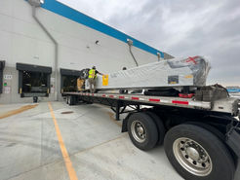
Caljan Multistage Extendable Installation

Slide 2
Step 1
Upon arrival of the Caljan Extendable, you will ensure that the truck driver is aware of which dock door he needs to unload which machine at. (left- or right-hand unit). This will be predetermined by the customer, and you will be provided this information prior to starting the job.
After you make sure the trailer is backed safely to the dock door, you then engage the dock locking mechanism, the truck must be backed up pressing against the rubber stoppers for the lock to engage. Followed by raising the dock leveler until it sits securely on the trailer as shown in this photograph. NOTE: You must raise the dock leveler all the way up until the lower ramp picks up and sets onto the trailer.
MAKE SURE THERE IS NO DAMAGE TO THE UNIT. WE HAVE FOUND DRIVERS THAT HAVE MOVED EXTENDO WITHOUT AUTHORIZATION TO DO SO.

Slide 3
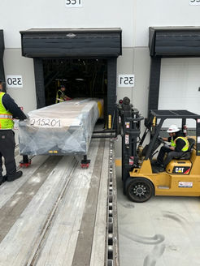
Step 2
Once the trailer is locked and the dock leveler is in place, you will need to raise the end of the machine using the supplied forklift and install a skate under each rear leg.
NOTE: You will raise the end of the machine nearest to the truck and you are ONLY allowed to lift the machine from the side, NEVER the ends of the machine without the use of a 4X6X8. See next slide.
See pictures.

Slide 4
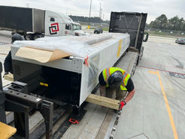
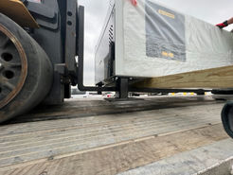
Step 3
After you have installed the skates at the rear of the machine making sure they are straight with the trailer, you will then drive the forklift inside of the facility so you can drive it onto the trailer to be able to unload the machine from the trailer. Reminder, as mentioned in the last slide, you are only able to lift the ends of the machine if you use a 4X6X8 piece of wood that is long enough to reach outside of both sides of the machine. Using this piece of wood allows you to lift the machine under the side rails, which is where the unit has the most support. See picture.
After the wood is under the machine and correctly positioned, you can then use the forklift to lift the machine using the wood. Be mindful of pinch points while positioning the wood between the machine and the forklift.

Slide 5
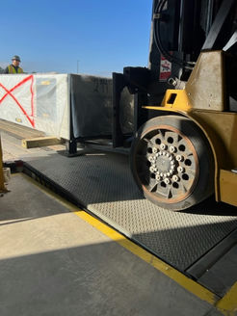
Step 4
Once you have the machine lifted using the wood, you can now safely and slowly drive the forklift in reverse to bring the machine inside the facility. See pictures.
NOTE: You must have a spotter watching the rear skates and dock door simultaneously to ensure the skates do not come out and dock door does not get damaged.

Slide 6
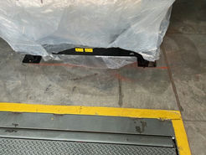
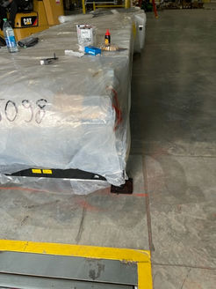
Step 5
After safely positioning the machine inside of the building, you will have to layout exactly where the machine will be installed in relation to the dock leveler plate.
You will be provided drawings of each layout for the job. Do not let the word “layout” overwhelm you, it is generally just two simple measurements depending on if you are installing a Caljan Extendable or a Maxxreach Extendable.
In this example, technicians are installing a Caljan machine, so they must layout the measurements as follows. The center of the machine should be 14” off center of dock leveler and 18” away from dock leveler seal plate to the front of the machine leg mount. See next slide.

Slide 7
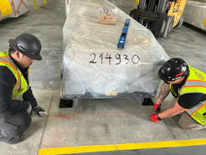
Step 6
In this illustration, we see that the dock plate is 60” wide.
Center of dock plate is 30”
Based off of the drawing, this machine will be 14” off center. After completing the “layout”, the center of the machine should be located at the blue arrow shown.
The machine should be positioned 18” from the edge of the dock plate to the front leg on the machine.
Check for square by measuring the distance between both front legs and the chalk line that was popped at 18”. This needs to be very precise because if not then the machine will enter the 18-wheeler trailer crooked later after the machine is commissioned.
The drawings for each machine will show the off set and distance from dock plates. If you are unsure, ask questions.
NOTE: Nearly all of the time, the offset to the left or right is the same as the control panel on the machine. If the control panel is on the left, the offset will be on the left and vice versa. There are only very few occasions that this will change.
14” off set
18”
30”C
60”

Slide 8
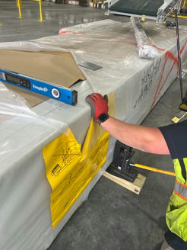
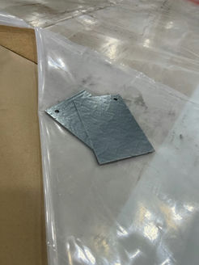
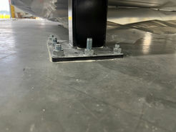
Step 7
Upon completing the layout, you will then need to use a 4ft digital level to ensure the machine is level from front to back and side to side. The digital level must read 0.05* or less. You may have to cut the plastic wrap on the machine to be able to level but, be mindful not to cut the belt of the machine.
Each machine is shipped with shims, which are in the control box mounted on the side of the unit. There are different thicknesses of shims that may be used.
Slide the correct shim under the leg of the machine and check to ensure the machine is level. See blue arrow.

Slide 9
Step 8
Now that the machine has been correctly positioned and leveled, you are ready to install the concrete anchors. NOTE: Before installing the concrete anchors, you must have a customer representative sign off on your Equipment Location Waiver in GoCanvas. This ensures the customer is happy with the location of the machine and accepts responsibility.
Using the correct anchors and concrete drill bit, you will begin drilling the anchor holes in every available hole on the foot of the machine and vacuuming or blowing the hole clean. Some machines will have mounting holes on the feet that are underneath the machine, you DO NOT have to install anchors at these locations.
Once all anchors are installed, make sure they are 1 turn past tight, and the anchor bolt does not protrude out of the top of the nut more than ½”. You can use a metal cutting blade to cut the anchor bolts shorter if needed. (If grinder is used then a hot permit will be required)
See next slide for concrete anchor tips.
Good
Not good and must be cut.

Slide 10
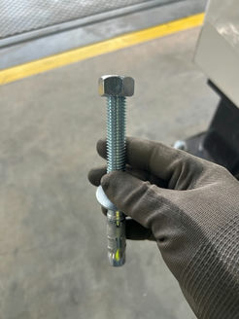
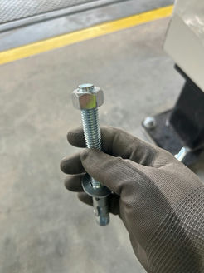
Step 9
After drilling the hole for the concrete anchor, you are now ready to install the anchor.
The most common method of installing the anchors are to beat them down in the hole with a hammer.
A common misconception is that the nut should be flush with the bolt as seen in Picture A when hitting the anchor with the hammer. This is not correct and will cause damage to the anchor threads.
The correct way is seen in Picture B. The top of the anchor threads has a slightly flared and not threaded portion, which is to be used to hit the anchor and drive it into the hole.
A
B

Slide 11
Step 10
Now that you are finished installing the Caljan unit, you will need to clean up any concrete dust, cut anchors and trash. Remember, clean up is a part of the job.
You will also need to call the forklift rental company and take the forklift off of rent. Be sure to ask for a “call off” number because you will be prompted to enter this in your Caljan WO.
See next few pages for installation layouts of the different multistage extendables.
Please remember, if you do not know or are unsure, ask questions first!
Provide pictures of location for extendo for location waiver
Provide pictures of extendo level and most sides of unit on work order

Slide 12
Commissioning
Use the checklist to the right when commissioning any multistage extendable.
When commissioning, another vendor on site will be responsible for running power to the newly installed unit.
WyCo will be responsible for making sure it’s operating as it’s supposed to.
All lights work? Machine turns on? Belt is tracking? ETC.

Slide 13
Caljan PM Checklist
When completing a Caljan PM, the checklist shown here must be used for each machine.
You will be provided copies of this checklist for each machine prior to arriving on site.

